Slide 1
OpenStack
Dr. Emmanuel S. Pilli

Slide 2
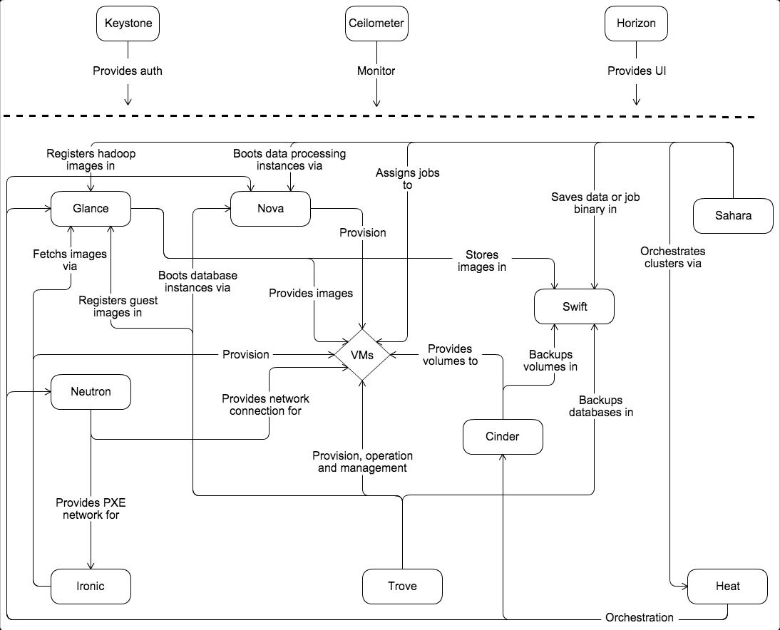
OpenStack Architecture

Slide 4
OpenStack Services
Dashboard Service(Horizon)
Network Service(Neutron)
Compute Service(Nova)
Bare Metal (Ironic)
Identity Service(Keystone)
Imaging Service(Glance)
Object Storage(Swift)
Block Storage(Cinder)
Database Service(Trove)
Orchestration Service(Heat)

Slide 5
OpenStack Services
Alarming (Aodh)
Key Manager (Barbican)
Telemetry (Ceilometer)
Block Storage (Cinder)
Rating service (Cloudkitty)
Policy (Congress)
DNS (Designate)
EC2 API service (EC2API)
Backup, Restore, and Disaster Recovery service (Freezer)
Image Service (Glance)
GLare Artifact Repository (Glare)
Time Series Database (Gnocchi)
Orchestration (Heat)
Dashboard (Horizon)
Bare Metal (Ironic)
Identity (Keystone)
Containers Orchestration (Magnum)

Slide 6
OpenStack Services
SharedFilesystems (Manila)
Workflow Service (Mistral)
Monitoring (Monasca)
Application Catalog (Murano)
Networking (Neutron)
Compute (Nova)
Load Balancer (Octavia)
Oslo Libraries (Oslo)
Benchmarking (Rally)
Data Processing (Sahara)
Clustering (Senlin)
Object Storage (Swift)
Testing (Tempest)
Deployment (TripleO)
Database Service (Trove)
Root Cause Analysis (Vitrage)
Resource Optimization (Watcher)
Message Service (Zaqar)

Slide 7
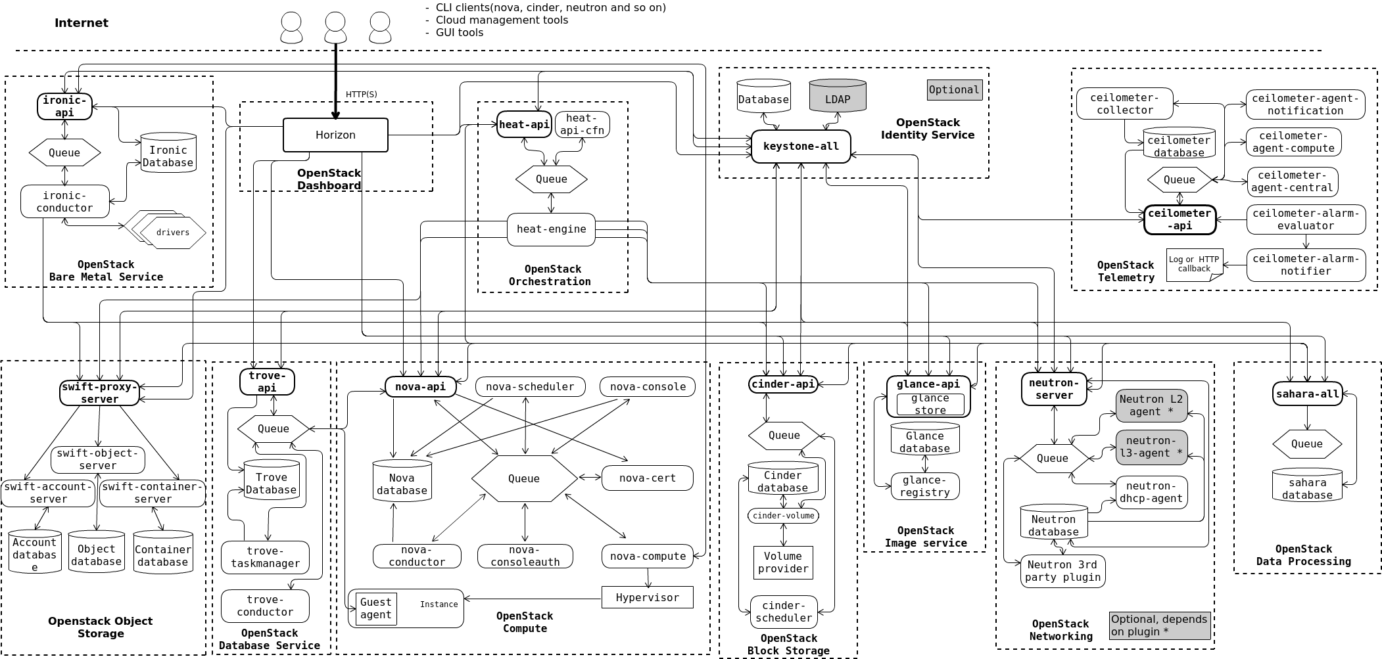
Logical Architecture

Slide 10
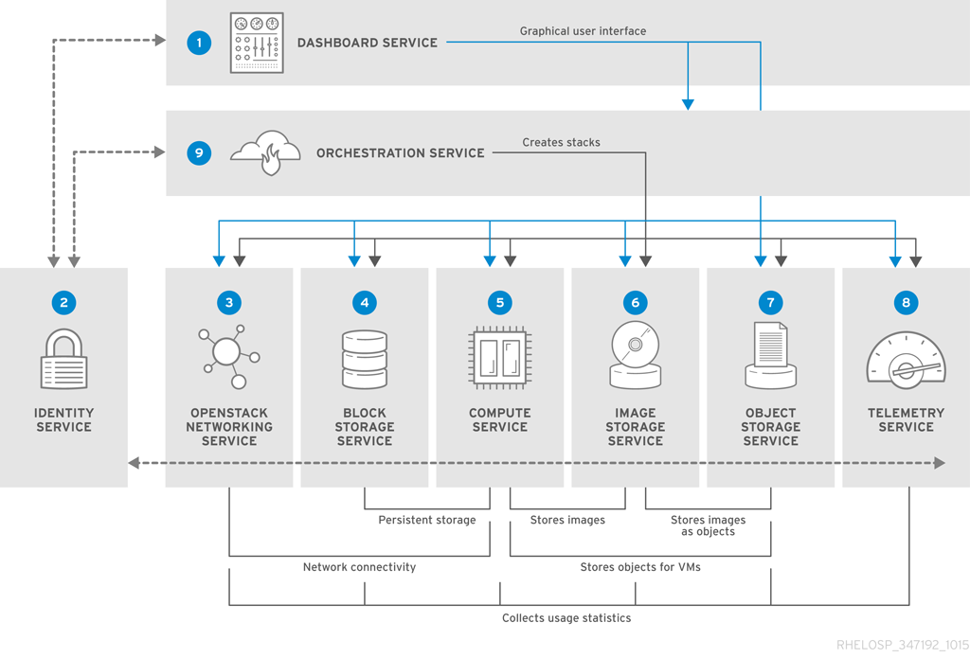

Slide 11
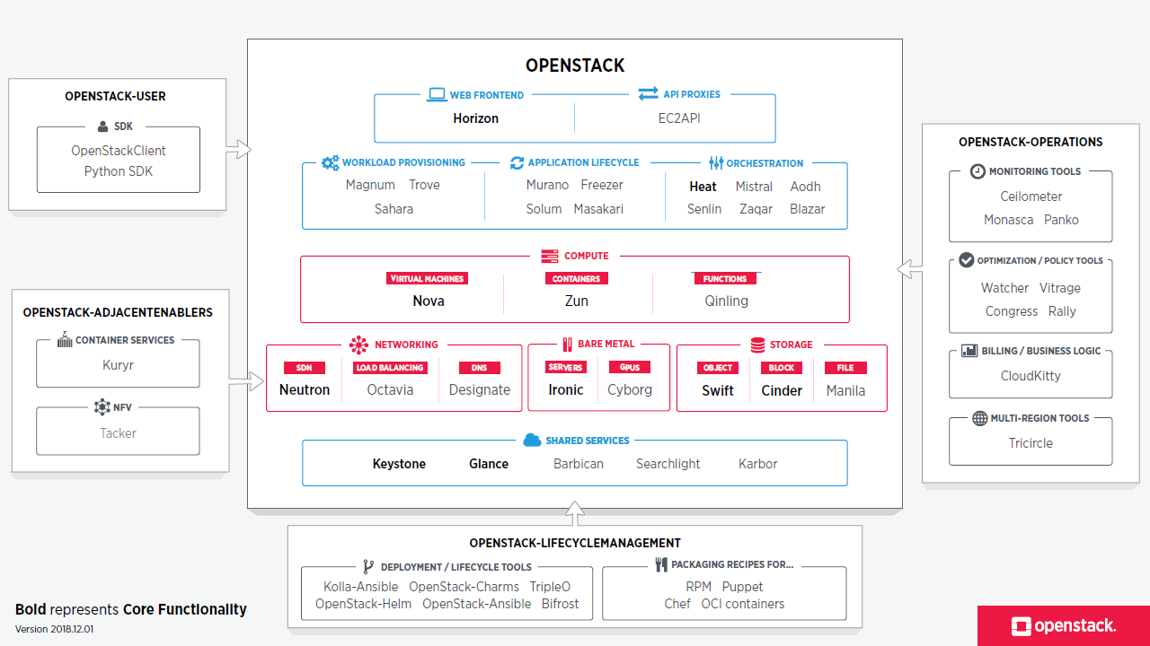
OpenStack

Slide 12
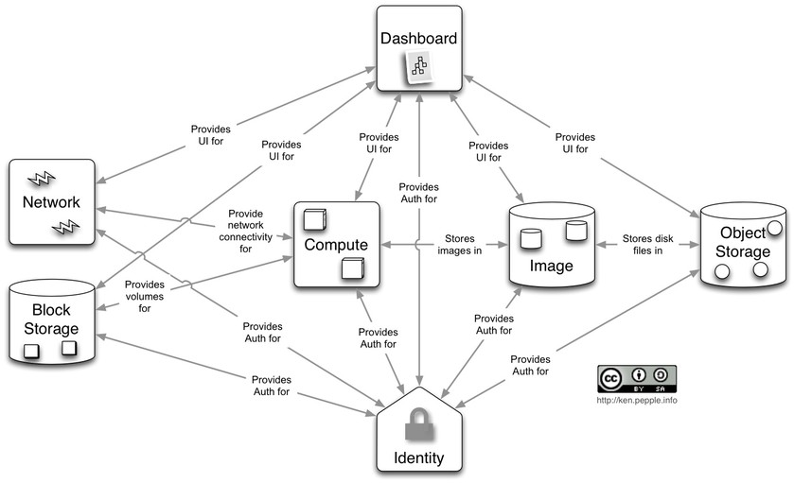
OpenStack Logical View

Slide 13
OpenStack Logical View
Keystone provides the authentication service

Slide 14
OpenStack Logical View
Nova provides computational services

Slide 15
OpenStack Logical View
Neutron (nova-network) provides network services

Slide 16
OpenStack Logical View
Glance provides image store

Slide 17
OpenStack Logical View
Cinder provides block persistent store

Slide 18
OpenStack Logical View
Swift provides object persistent store

Slide 19
OpenStack Logical View
Horizon provides web user interface

Slide 20
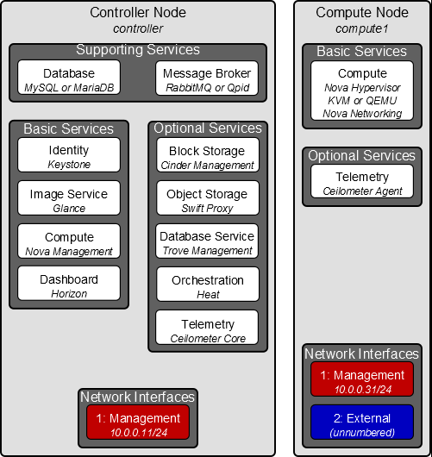
Two Node Architecture

Slide 21
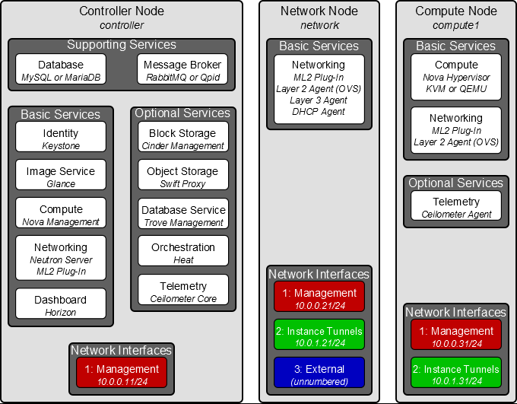
Three Node Architecture

Slide 22
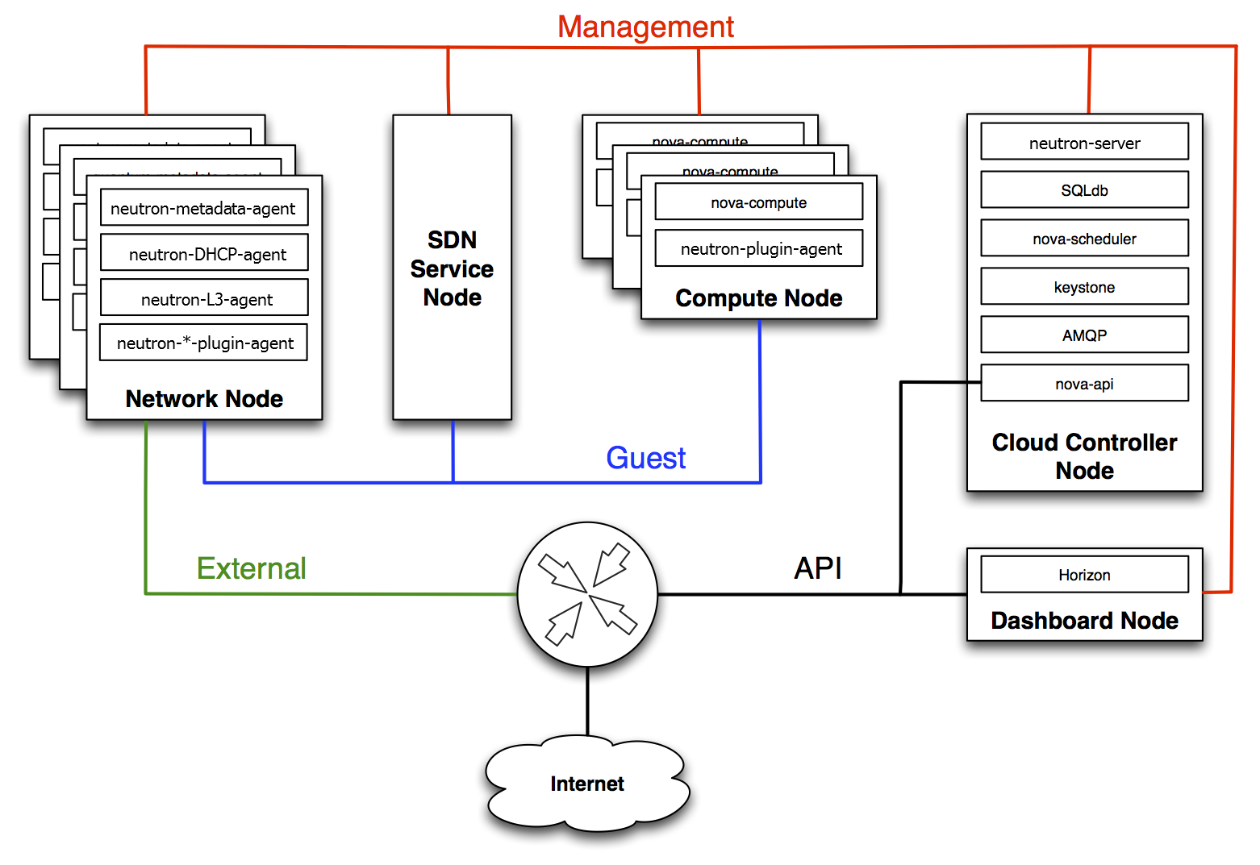

Slide 23
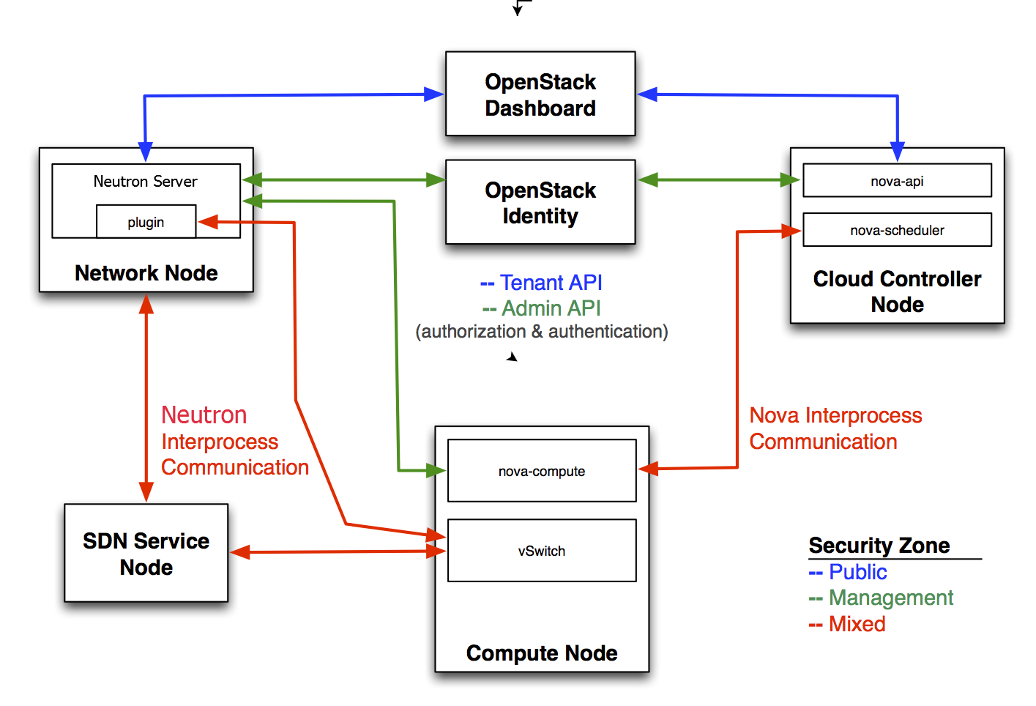
Three Node Architecture
https://us02web.zoom.us/j/4025161624
https://us02web.zoom.us/j/4025161624

Slide 24
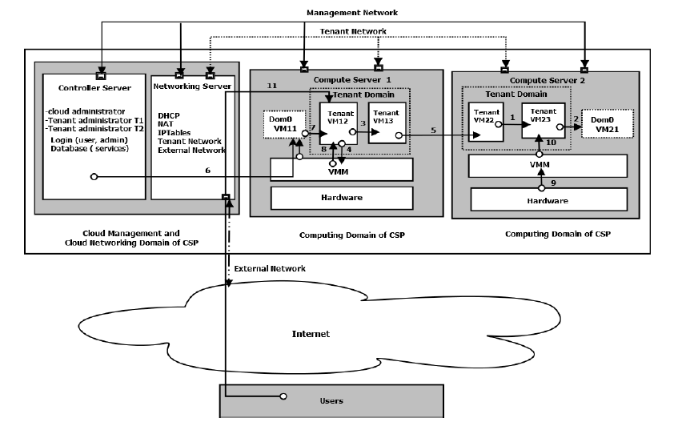
Four Node Architecture

